Slide 1



Gulf, Franklin, Liberty, Gadsden Counties
Freight Logistic Zone
Gulf County Economic Development Coalition
Technical Assistance Grant FY 2016-2017
October 12, 2016

Slide 2
Section 311.103, Florida Statutes
Designation of state freight logistic zones
“Freight Logistics Zone” grouping of activities/infrastructure associated with freight transportation/related services within a defined area around an intermodal logistics center as defined in s. 311.101(2).
“Intermodal Logistic Center” including, but not limited to, an “inland port”, means a facility/group of facilities serving as a point of intermodal transfer of freight in a specific area physically separated from a seaport where activities relating to transport, logistics, goods distribution, consolidation, or value-added activities carried out and whose activities and services are designed to support or be supported by conveyance or shipping through one or more seaports listed in s. 311.09

Slide 3
Purpose of the Freight Logistic Zone
Identify a zone and supporting infrastructure that serves a strategic interest in the region and the State.
Collect and analyze freight activity data and needed infrastructure improvements
Needed infrastructure improvements to be considered for priority on state funding

Slide 4
Preliminary Areas of Interest for FLZ
FDOT District 3 Freight Infrastructure
Freight Infrastructure in the 4-counties and surrounding area
Strategic Intermodal Systems (SIS) highways, railroads, airports, seaports
Non-SIS State highways, general aviation airports
Warehousing, Distribution centers, trucking terminals
Foreign Trade Zones
Truck data
Industrial/Commercial Comprehensive Plan FLUM designations
Strategic Sites
Clusters of Industrial Uses

Slide 5
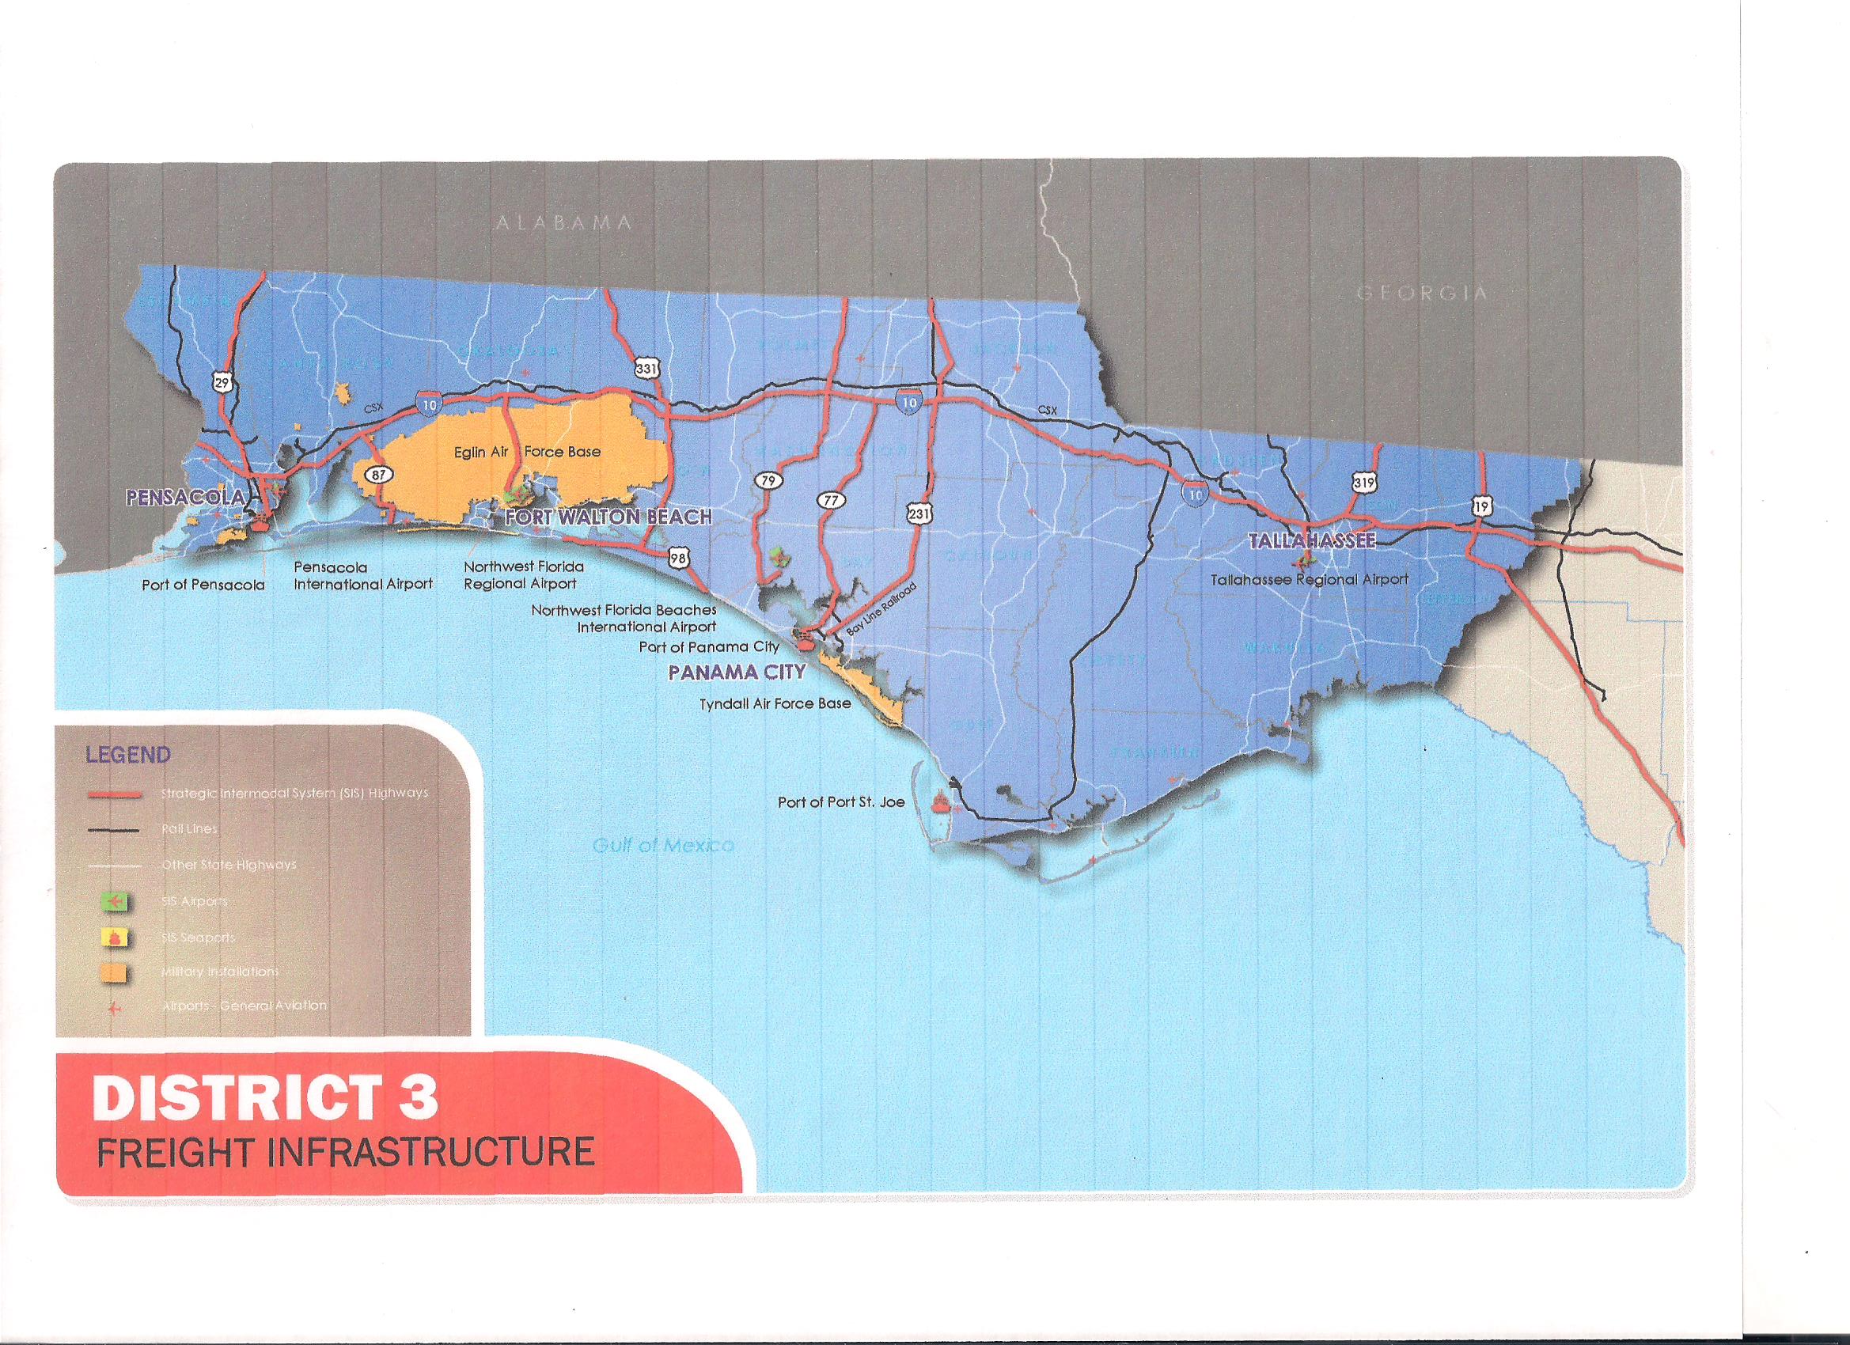
FDOT District 3 Freight Infrastructure

Slide 6
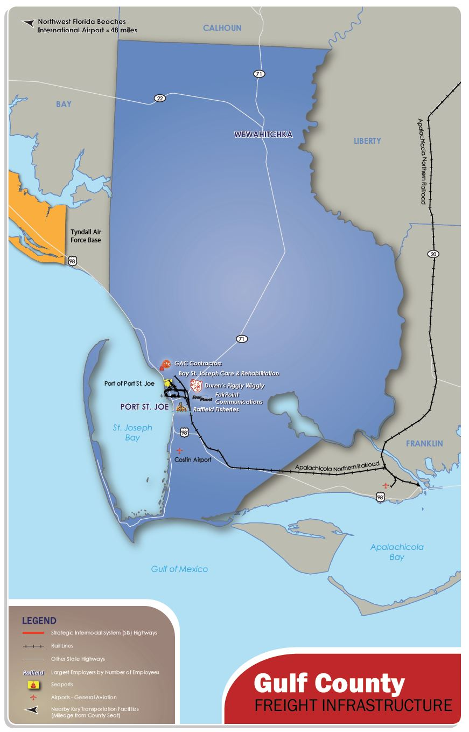
Gulf County Freight Infrastructure

Slide 7
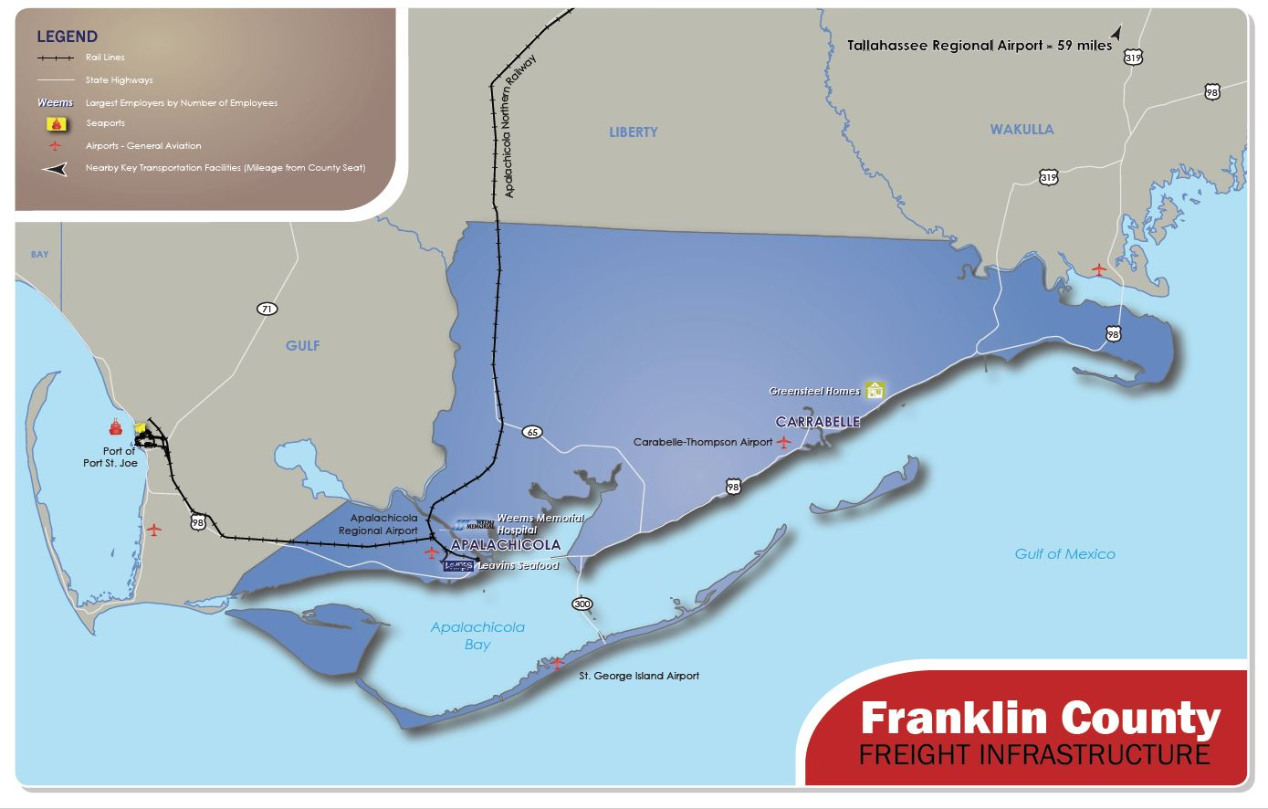
Franklin County Freight Infrastructure

Slide 8
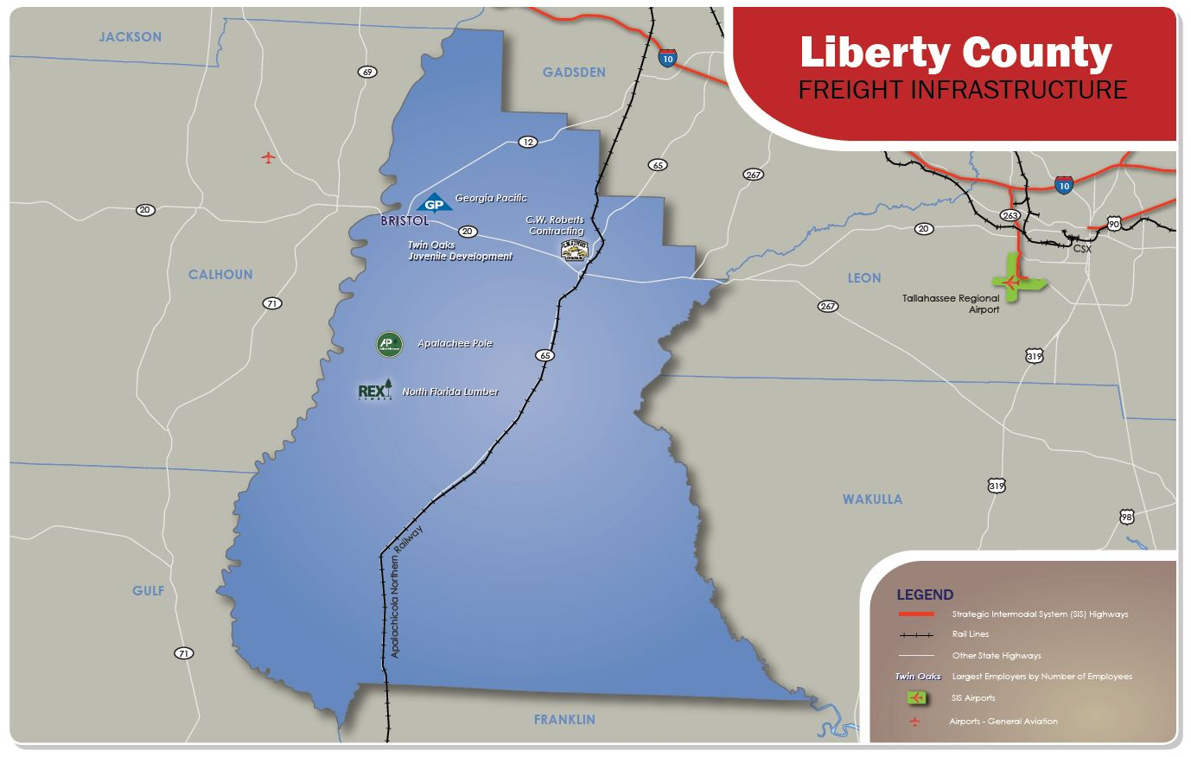
Liberty County Freight Infrastructure

Slide 9
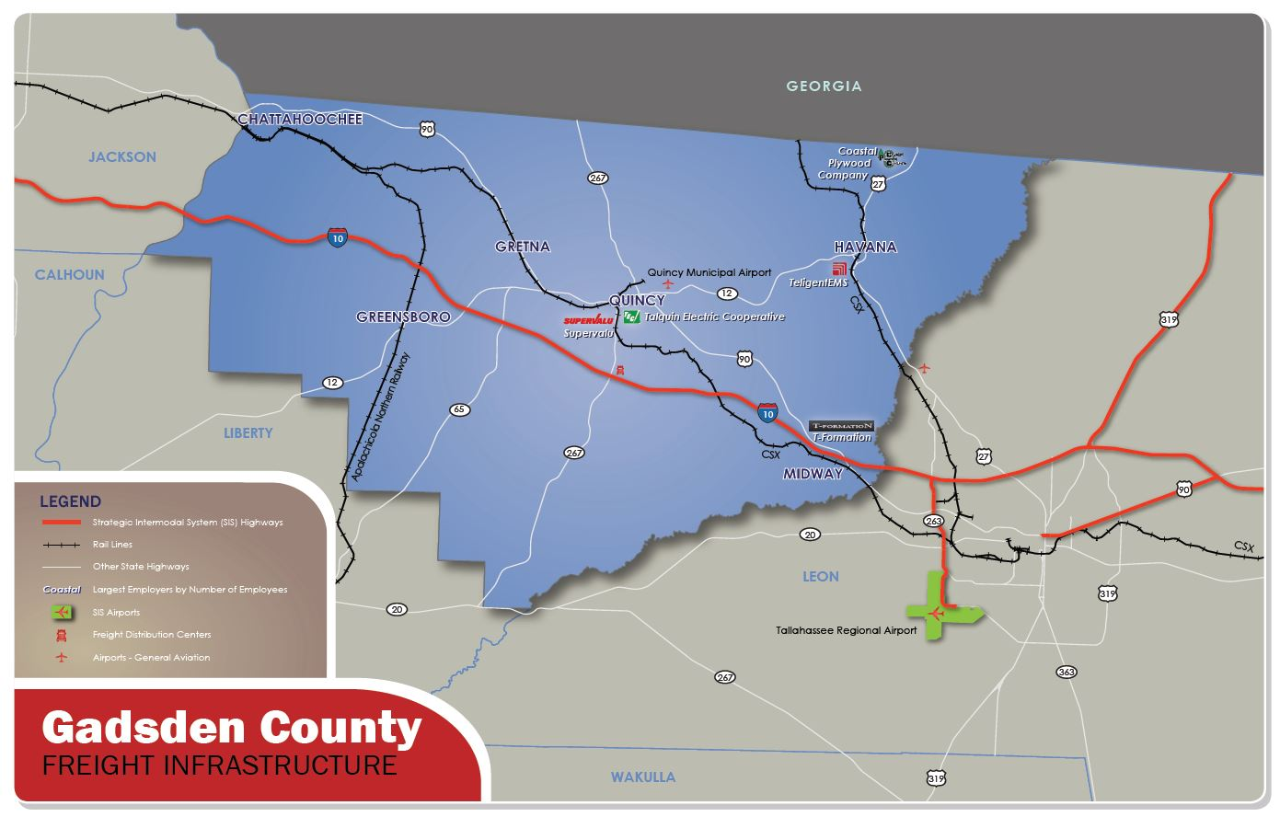
Gadsden County Freight Infrastructure

Slide 10
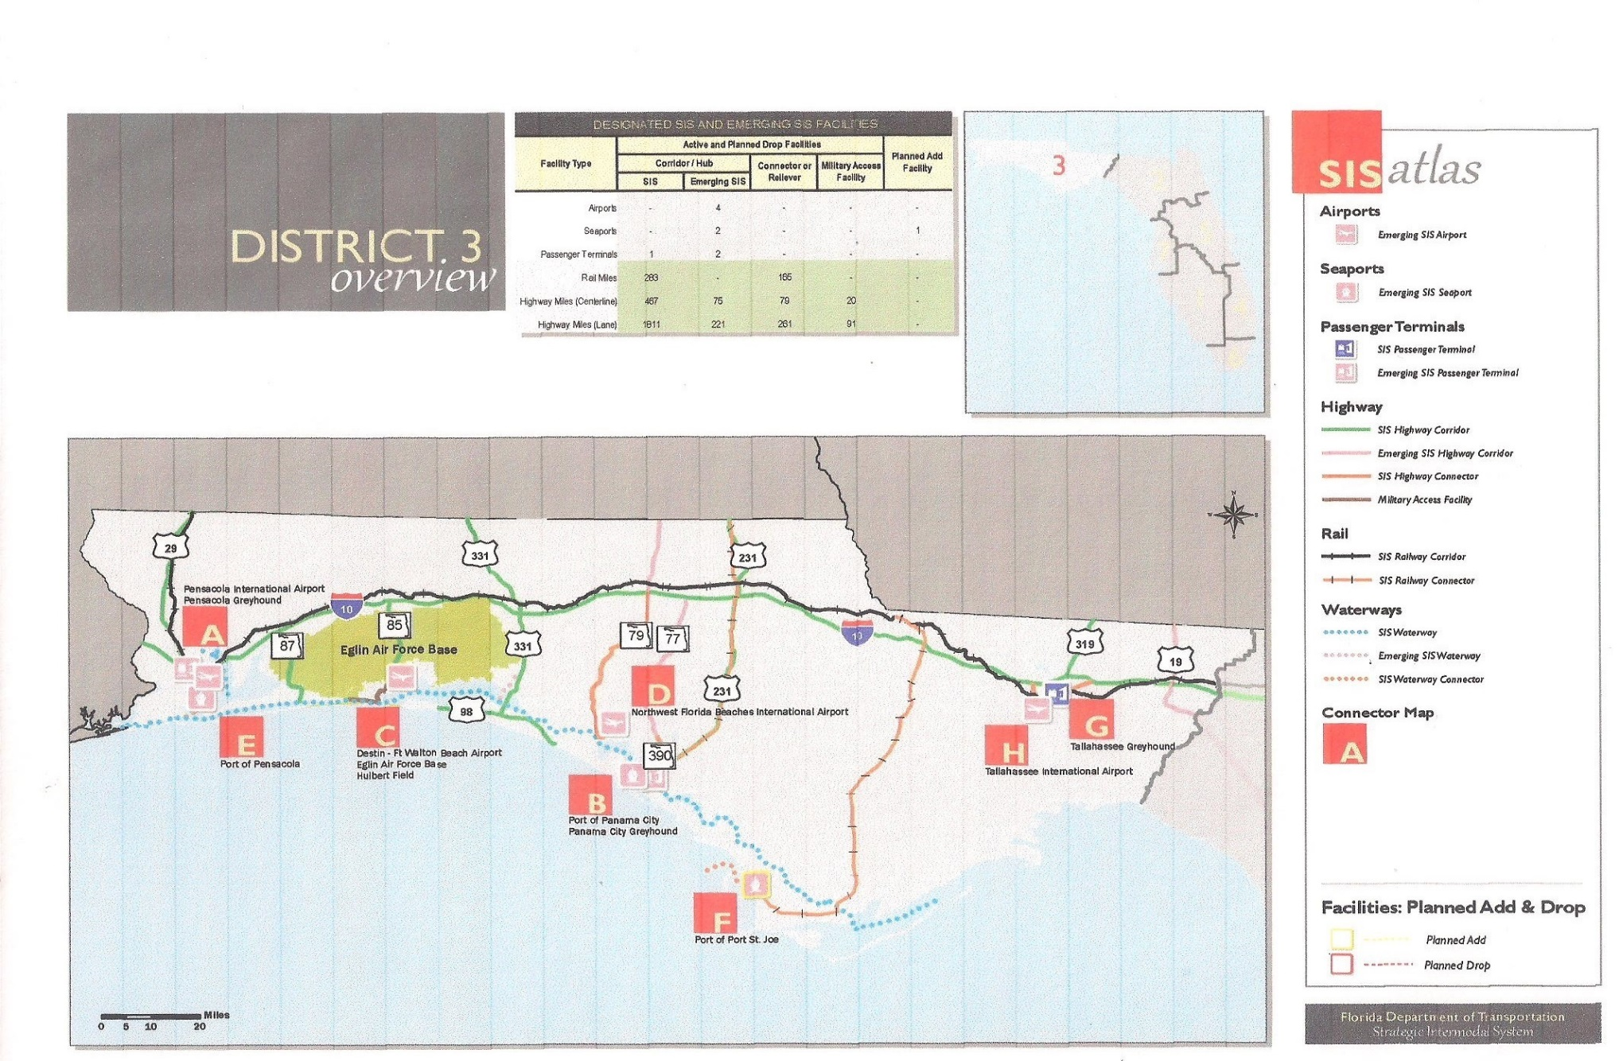
FDOT District 3 SIS Facilities

Slide 11
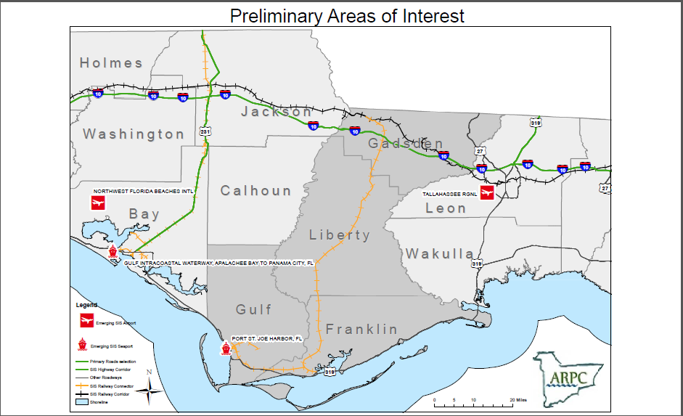
FDOT District 3 SIS Facilities

Slide 12
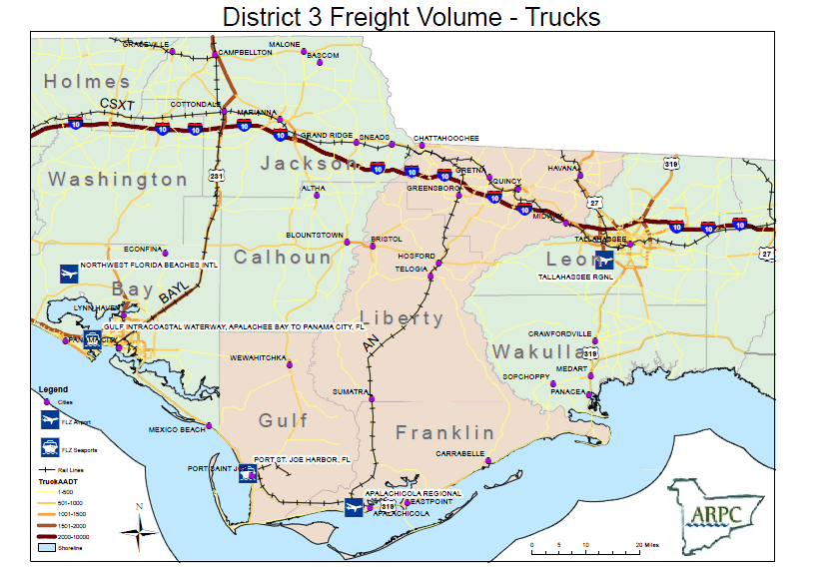
Inclusive Map & Truck Data

Slide 13
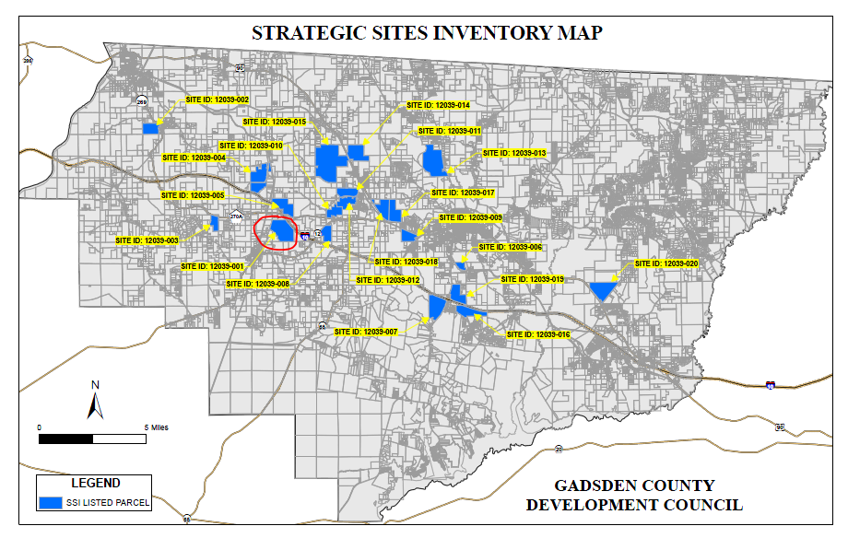
Strategic Sites Inventory and ILC

Slide 14
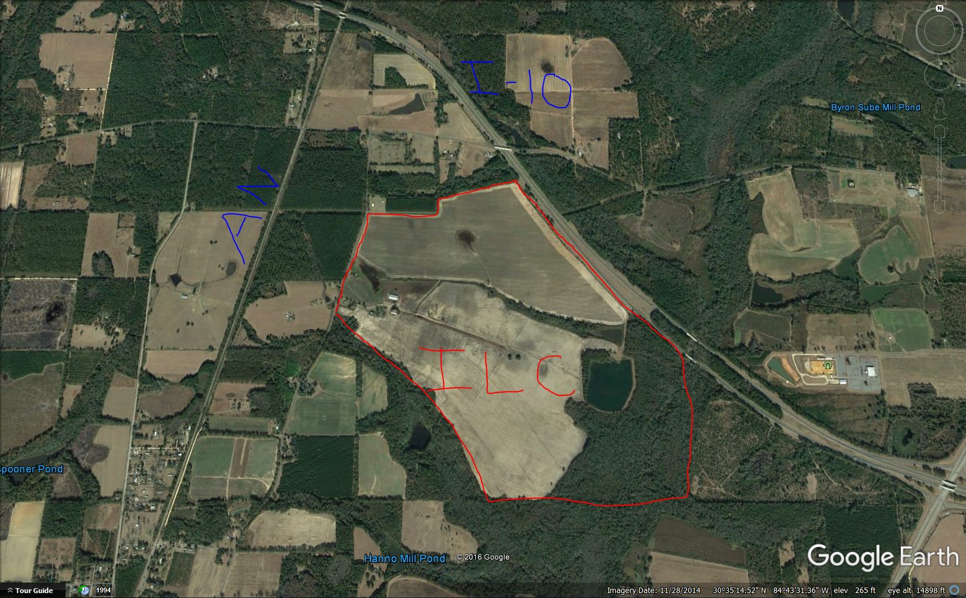
Proposed Intermodal Logistics Center

Slide 15
Timetable
October 14, 2016: Deliverable #1. Working Group Summit 1/Map preliminary areas of interest for proposed FLZ
December 15, 2016: Deliverable #2. Strategic Sites Inventory Report
March 31, 2017: Deliverable #3. Draft Strategic Plan for proposed FLZ
May 15, 2017: Deliverable #4. Working Group Summit 2
June 15, 2017: Deliverable #5. Public Hearings and Final Strategic Plan

Slide 16
Questions?
Bruce Ballister – ARPC Economic Development
Kwentin Eastberg - ARPC Transportation Consultant
Marina Pennington – Planning Consultant
Victor Leotta – LEO, LLC

